Slide 1
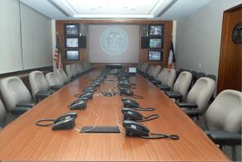
Establishing and Operating
an Emergency Operations Center
Center for Global Health
Division of Global Health Protection

Slide 2
Learning Objectives
Participants will be able to:
Describe the purpose of an EOC
List the possible components and design of an EOC

Slide 3
What is an EOC?
The physical location at which the coordination of information and resources to support incident management activities normally takes place

Slide 4
Why have an EOC?
To support decision-makers in the accomplishment of their tasks
To provide the capability to receive, analyze, display, and monitor incident information
To be able to identify, organize, deploy, and track resources
To be able to communicate, collaborate, and coordinate from a centralized location

Slide 5
What Does an EOC Do?
Responsible for the strategic or operational overview of the incident
Normally does not directly control field assets
Common functions include:
information collection and analysis
make decisions that protect life and property
maintain continuity of the organization
disseminate decisions to all concerned agencies and individuals
In most EOCs there is one individual in charge, and that is the Emergency Manager

Slide 6
EOC Organization Principles
Provides a management structure that results in better decisions and more effective use of available resources
Designed for incidents that may involve multiple agencies and political jurisdictions.
Should be modular – able to expand or contract as incident grows or ends

Slide 7
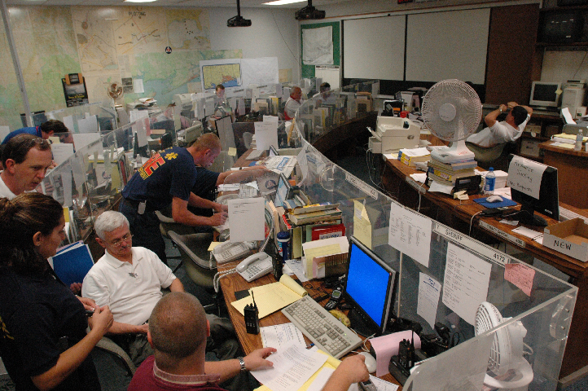
Developing an EOC
The development process should include:
Mission
Communications Process
Operational Approach
Organization Design
and Structure
Facility Design Considerations
September, 2005, Gulfport, MS

Slide 8
Define the EOC’s Mission
Mission analysis:
What will the EOC to do?
What functions will the EOC perform?
How will the EOC be staffed?
Under what conditions will the EOC operate?

Slide 9
Define the EOC’s Mission
Review documentation to identify responsibilities:
Regulations
Legislation
Laws and Codes
Directives
Memorandums
Standard Operating Procedures

Slide 10
Communications
Who will the EOC communicate with?
What will be communicated to or by the EOC?
Notifications, warnings, reports
How often will communications occur?
Daily, weekly, normal operating hours, after hours
What is the standard process for communicating with stakeholders?
Telephone, email or site visits
Are there alternate/redundant systems?

Slide 11
Operational Approach
Do you have 24hour a day/7 days a week operation or a “business hours” operation?
Will you have a telephone answering service?
How do you want to operate?
A representative for each region or organization within the Ministry?
Organizational design is driven by:
Roles and responsibilities of staff
Skill and knowledge of personnel
Number of personnel

Slide 12

Response Reporting
Event-specific
Situation reports (SITREP)
Shift change reports
Incident Action Planning (IAP)
Spot reports
Joint Information Center (JIC)
Health Alert Network (HAN)
Epidemiology Information Exchange (Epi-X)

Slide 13
Facility Design Considerations
Location
Size
Layout
Facility Use
Technology
Threats/ Vulnerabilities
Notes:
4

Slide 14
Location
When choosing a location consider:
Proximity to collaborative organizations
Available for use
Are there regulatory restrictions?
Are there existing structures that are compatible?
Infrastructure support

Slide 15
Size
Size will depend on the staff requirements to accomplish the mission
Ideal size would have sufficient space to hold all the personnel required to respond to a full-scale incident
Layout of the EOC should be tailored to meet organizational design requirements

Slide 16
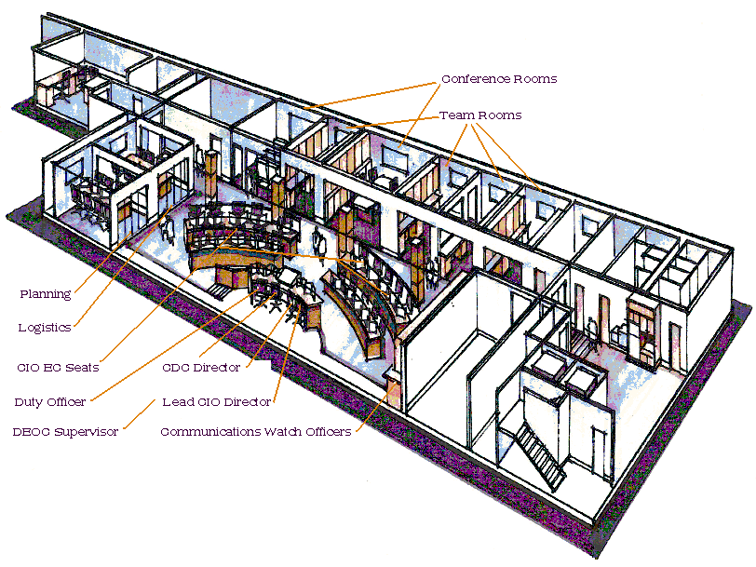
Layout
Communication and eye contact between decision makers
Space for:
Operational
Coordination
Decision Making
Collaboration
Communications

Slide 17
Facility Use
Will the EOC be dedicated space, available at any time and for any length of time needed?
Will the facility be for response use only?
Will personnel work in the EOC daily?
Will training be conducted in the EOC?
If space is shared, consider:
How long will it take to transition?
Who will maintain readiness of equipment?
What happens to the displaced persons?

Slide 18
Technology
EOC
Telephones
&
Cellular
Satellite
Systems
Blackberry
Radio
Internet
Video
Display
Video
Tele-
conference
Audio
Bridge
Line
Television
What technologies are available and can be implemented to enhance EOC performance?

Slide 19
Threats and Vulnerabilities
Power disruption
Physical attack
Fire
Severe Weather
Flooding
Earthquakes
Telecommunications disruption
Environmental factors (heating and cooling)

Slide 20
Final Thoughts
The importance of plans and the IMS response structure for both internal organizational use and in coordination with external partners cannot be overemphasized
Flexibility and adaptation of the response structure and operations are critical for improving future operations
Training new personnel and conducting exercises ensures much more effective and efficient response when an emergency occurs
There are challenges…
Contingency and sustained funding for responses
Accountability and sustainment for staffing for long response

Slide 21
For more information please contact Centers for Disease Control and Prevention
1600 Clifton Road NE, Atlanta, GA 30333
Telephone: 1-800-CDC-INFO (232-4636)/TTY: 1-888-232-6348
Visit: www.cdc.gov | Contact CDC at: 1-800-CDC-INFO or www.cdc.gov/info
The findings and conclusions in this report are those of the authors and do not necessarily represent the official position of the Centers for Disease Control and Prevention.
Center for Global Health
Division of Global Health Protection

